Slide 1
Rhetorical Vocabulary
AP Language

Slide 2
RHETORICAL VOCAB
INTERRUPTION (2)
OMISSION (2)
REPETITION (5)
BALANCE (6)
COMPARISON (7)
WORD PLAY (14)
FOLDABLE SETUP

Slide 3
Interruption (2)

Slide 4
Parenthesis
DEFINITION:
the insertion of words, phrases, or a sentence that is not syntactically related to the rest of the sentence. It is set off by dashes or parentheses.
“The regulation poster in the single unisex restroom admonishes us to wash our hands thoroughly, and even offers instructions for doing so, but there is always some vital substance missing--soap, paper towels, toilet paper--and I never found all three at once.” (Barbara Ehrenreich, Nickel and Dimed)

Slide 5
Appositive
DEFINITION:
A noun, phrase or clause which follows a noun or pronoun and renames or describes the noun or pronoun.
Whetstone’s Wacky Way of Remembering:
With this information inserted into the sentence, the reader is now more “positive” he or she knows who is the subject of the sentence.
“Its unquestioned leader, Paul Broca, professor of clinical surgery at the Faculty of Medicine in Paris, gathered a school of disciples and imitators around himself.”
(Stephen Jay Gould, from Women’s Brains).

Slide 6
Omission (2)

Slide 7
Asyndeton
Definition:
A writing style that omits conjunctions between words, phrases, or clauses
“Doubt, Desire, Sorrow, Remorse, Indignation, Despair itself, all these like helldogs lie beleaguering the soul of the poor dayworker…”
(Thomas Carlyle, from Labour)

Slide 8
Polysyndeton
DEFINITION
The deliberate use of many conjunctions between phrases, clauses, or words
**THIS FALLS INTO “OMISSION” BECAUSE THE WRITER IS CHOOSING TO OMIT PUNCTUATION.
“If she tried, he’d argue and wheedle and sulk and bully and plain wear her down.”
(JEANNETTE WALLS, The Glass Castle, page 76)

Slide 9
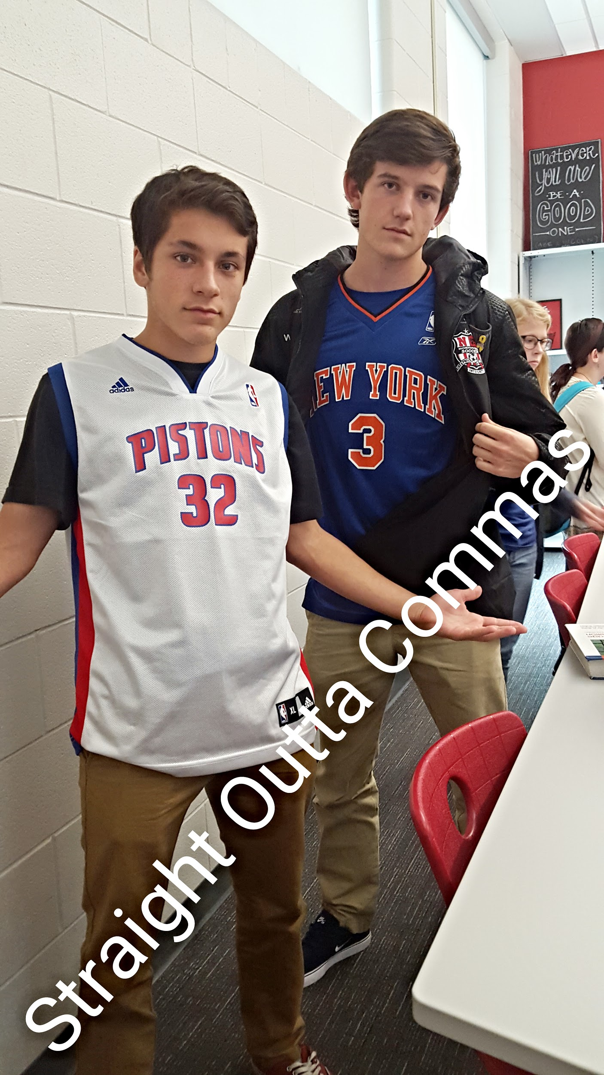
so remember when you are dealing with polysyndeton you are….
Notes:
hahaha nice… those boys :)

Slide 10
Repetition (5)

Slide 11
Anaphora
Definition
Deliberate repetition of a word or phrase at the beginning of several successive verses, clauses, or paragraphs.
Whetstone’s Wacky Way:
repetition is at beginning of phrases or clauses, anaphora begins with “A” which is at the beginning of the alphabet.
“We shall not flag or fail. We shall go on to the end… we shall fight in the fields and in the streets, we shall fight in the hills; we shall never surrender.”
(Winston Churchill, WWII speech)

Slide 12
alliteration
DEFINITION
words following each other or close together that start with the same consonant sound.
WHETSTONE’S WACKY WAY:
the double “l” in the term “alliteration” might help one remember that he or she is to look for a repetition of consonant sounds in progressive words.
“The crusade to create a chemically sterile, insect-free world seems to have engendered a fanatic zeal…”
(Rachel Carson, from Silent Spring)

Slide 13
anadiplosis
DEFINITION
repetition of the last word at one clause and beginning of the next clause
When your cable is on the fritz, you get frustrated. When you get frustrated, your daughter imitates. When your daughter imitates, she gets thrown out of school. When she gets thrown out of school, she starts making bad choices. When she starts making bad choices, she meets undesirables. When she meets undesirables, she ties the knot with undesirables. When she ties the knot with undesirables, you get a grandson with a dog collar.”
(DirectTV Commerical, 2012)

Slide 14
climax
DEFINITION
Repetition of words, phrases, or clauses in order of increasing number or importance
“I do not believe that any of us would exchange places with any other people or any other generation.”
(John F. Kennedy, Inauguration Speech, 1961)

Slide 15
epistrophe
DEFINITION
repetition of a word or expression at the end of successive phrases, clauses, sentences, or verses especially for rhetorical or poetic effect.
Whetstone’s Wacky Way:
repetition comes at the end of phrases or clauses, the word end begins with the letter “e” as does the word “epistrophe”
“ [...] that this nation, under God, shall have a new birth of freedom -- and that government of the people, by the people, for the people, shall not perish from the earth.”
(Abraham Lincoln, Gettysburg Address)

Slide 16
Balance (6)

Slide 17
Parallelism (words, phrases, clauses)
DEFINITION
The repetition of similar grammatical or syntactical patterns.
WORDS
“Something must be done, and done speedily, and in this distress the wisest are tempted to adopt violent means, to proclaim martial law, corporal punishment, mechanical arrangement [...] and main strength.”
(Ralph Waldo Emerson, from Education)

Slide 18
Parallelism (words, phrases, clauses)
DEFINITION
The repetition of similar grammatical or syntactical patterns.
Phrase= more than a couple of words, but not a complete sentence
PHRASES
“My fellow citizens: I stand here today humbled by the task before us, grateful for the trust you have bestowed, mindful of the sacrifices borne by our ancestors.”
-Barack Obama

Slide 19
Parallelism (words, phrases, clauses)
DEFINITION
The repetition of similar grammatical or syntactical patterns.
Whetstone’s Wacky Ways:
Clause= Complete Sentence
CLAUSES
In college, he ran a laundry service, he organized student charter flights to Europe, he went to see basketball games with his friends, and he went to business school in New York.
(Malcolm Gladwell, David and Goliath)
Notes:
all parts are clauses (could be complete and stand alone) and all begin with “he (verb)”

Slide 20
Antithesis
“Instead of a macho, trigger-happy man our culture has perversely wanted him to be, the cowboy is more apt to be convivial, quirky, and soft-hearted.”
(Gretel Ehrlich, “About Men”)
“We shall support any friend, oppose any foe”
(JFK Inauguration Speech)
DEFINITION
Parallel structure that juxtaposes contrasting ideas
Words:
"Engaged yet detached"

Slide 21
Zeugma
DEFINITION
A figure in which more than one item in a sentence is governed by a single word, usually a verb.
“She looked at the object with suspicion and a magnifying glass”
(Charles Dickens, I Love India).

Slide 22
Antimetabole
DEFINITION
Words are repeated in different grammatical forms.
When the going get tough, the tough get going.
It’s not about the size of the dog in the fight, but the size of the fight in the dog.
And so, my fellow Americans: ask not what your country can do for you, but what you can do for your country.”
(John F. Kennedy, Inauguration Speech, 1961)

Slide 23
Comparison (7)

Slide 24
Allusion
DEFINITION
An expression designed to call something to mind without mentioning it
“Just as the prophets of the eighth century B.C. left their villages and carried their ‘thus saith the Lord’ far beyond the boundaries of their home towns, and just as the Apostle Paul left his village of Tarsus and carried the gospel of Jesus Christ to the far corners of the Greco-Roman world, so am I compelled to carry the gospel of freedom beyond my own home town. Like Paul, I must constantly respond to the Macedonian call for aid.”
(Martin Luther King, Jr. “Letter from Birmingham Jail”)

Slide 25
Simile
DEFINITION
To compare two unlike things using the connecting words like or as.
“Our life is like a German Confederacy, made up of petty states, with its boundary forever fluctuating, so that even a German cannot tell you how it is bounded at any moment”
(Henry David Thoreau, “Where I Lived, and What I Lived For”)

Slide 26
metaphor
A figure of speech that makes a direct comparison between two unlike things
DEFINITION
With both hands over his heart he broke into an Irish tenor’s rendition of “Maria” from West Side Story [...] But Maria had followed me to London.”
(Judith Ortiz Cofer, “Myth of a Latin Woman”)

Slide 27
Synechdoche
DEFINITION
metaphor where the part stands for the whole: seems more literal
"Lend me a hand..."
“Is Google Making Us Stupid?”
(Nicholas Carr, July/August 2008 Issue of The Atlantic)
PART
WHOLE
Notes:
not sure why, but the triangles help me remember. point being part, base being whole. as long as I remember which triangle goes with which word, this makes it easier for them. If you want to not explain this, or tell the non-visual kids to ignore, that’s what I do

Slide 28
Metonymy
DEFINITION
A figure of speech in which one word or phrase is substituted for another with which it is closely associated at a deeper level
(such as "crown" for "royalty"; “lend me your heart”).
“The British crown has been plagued by scandal.”
(Queen Elizabeth II speech)

Slide 29
personification
DEFINITION
Giving human qualities to something that is not human
“The plane moved every way a line can move, and it controlled three dimensions, so the line carved massive and subtle slits in the air like sculptures.”
(Annie Dillard, from The Writing Life)

Slide 30
Periphrasis
DEFINITION
A trope in which one substitutes a descriptive word or phrase for a proper noun
"The Big Apple"
“And let every other power know that this Hemisphere intends to remain the master of its own house.”
(John F. Kennedy, Inauguration Speech, 1961)

Slide 31
Word Play (14)

Slide 32
Pun
DEFINITION
the use of similar or identical sounding words to create an alternate meaning to the sentence in which they are used.
“Hospitals are sued by seven foot doctors”
(eRepublik, article headline, 2010)
Notes:
Usually on this day, I start a “That’s so Punny” on the white board. I’ve printed off top puns and take them from there and update daily for most of the remainder of the year. Should be found inside of last year’s Composition Notebook. Just a fun touch :)

Slide 33
sarcasm
DEFINITION
A style of bitter irony intended to hurt or mock its target
MILFORD, CT—Intermittently gnawing at an old apple core and scratching at his unruly bramble of stubble, 22-year-old Daniel Hardin admitted to reporters Thursday that he had become completely broke and homeless 10 days after taking control of his own finances.
(The Onion, 22-Year-Old Broke, Homeless 10 Days After Taking Control Of Own Finances)
Notes:
note: The Onion news source. Use this as a reference to satire and how the entire website it satirical. The Onion was on the 2005 Rhetorical Analysis, many students failed miserably because they couldn’t recognize satire or sarcasm.

Slide 34
rhetorical question
DEFINITION
a question that is asked merely for effects
Public opinion resented it before, public opinion accepts it now, and is happy in it. Why? Was the resentment reasoned out?”

Slide 35
irony
DEFINITION
the use of words to convey a meaning that is the opposite of its literal meaning
“Here was I--a white man with his gun, standing in front of the unarmed native crowd--seemingly the leading actor of the pieces; but in reality I was only an absurd puppet pushed to and fro by the will of those yellow faces behind.”
(George Orwell, “Shooting an Elephant”)

Slide 36
oxymoron
DEFINITION
A figure of speech that combines two usually contradictory terms in a compressed paradox
“I was sitting there red-faced and quiet, and my mother, the real Mrs. Tan, was shouting at his boss in her impeccable broken English.”
(Amy Tan, “Mother Tongue”)

Slide 37
imperative sentence
DEFINITION
A sentence used to command, implore, enjoin, or entreat
“My fellow citizens of the world: ask not what America will do for you, but what together we can do for the freedom of man.”
(John F. Kennedy, Inauguration Speech, 1961)

Slide 38
hortative sentence
DEFINITION
Sentence that exhorts, advises, calls to action
“Let both sides explore what problems unite us instead of belaboring those problems which divide us.”
(John F. Kennedy, Inauguration Speech, 1961)

Slide 39
Satire
DEFINITION
An ironic, sarcastic, or witty composition that claims to argue for something, but actually argues against it.
“I have been assured by a very knowing American by my acquaintance in London, that a young healthy child well nursed is at a year old a most delicious, nourishing, and wholesome food, whether stewed, roasted, baked, or broiled, and I make no doubt that it will equally serve in a fricassee or a ragout.”
(Jonathon Swift, A Modest Proposal)

Slide 40
euphemism
DEFINITION
mild, indirect or vague term substituting for a harsh, blunt form of an offensive term
"passed away" vs. "died"
“They will hand over the terrorists, or they will share in their fate.”
(George W. Bush “After 9/11” speech)

Slide 41
hyperbole
DEFINITION
Also known as overstatement; exaggeration used to emphasize a point.
“I find myself, every September, increasingly appalled by the dismal lists of texts that my sons are doomed to waste a school year reading.”
(Francine Prose, I Know Why A Caged Bird Cannot Read)

Slide 42
litotes
DEFINITION
a particular form of understatement generated by denying the opposite of the word which would otherwise be used
“Indeed, it is not uncommon for slaves even to fall out and quarrel among themselves about the relative goodness of their masters…”
(Frederick Douglass, Narrative of the Life of Frederick Douglass: An American Slave).

Slide 43
logos
DEFINITION
logical appeal of a speaker to main elements are evidence and reasoning
“In urban areas, for young women and girls, ages 15-19, the prevalence rate was 15.4%. For young men and boys of the same age, it was 1.2%. For young women between 20 and 24, the rate was 29.7%. For young men of that age it was 8.4%.”
(Stephen Lewis, AIDS Has a Woman’s Face)
Notes:
Use ASPCA commercials here too: “just 60 cents a day..”

Slide 44
pathos
DEFINITION
an appeal to one's emotions
“I ask you to live your lives and hug your children. I know many citizens have fears tonight, and I ask you to be calm and resolute, even in the face of a continuing threat.”
(George W. Bush, “After 9-11 Speech”).
Notes:
I always reference ASPCA commercials here.. the use of emotions. SHREDS me heart every time.

Slide 45
ethos
DEFINITION
“I have a Doctorate’s Degree in NeuroEconomics and have been studying oxytocin for over ten years…”
(Dr. Paul Zak, Ted Talk, “Trust, Morality, and… Oxytocin?”)
speaker's credibility to speak about subject (whether automatic --someone well known, such as The Queen, Oprah, Stephen King--or earned through reputation and accomplishments.

